Slide 1
Voice Controlled Robot Domain - Robotics
By
R Hariharan

Slide 2
Introduction
Humans have tried to control robots since ages.
People have succeeded in doing so with gesture, control from computer, and even with voice.
I feel voice is the best way to show your authority

Slide 3
Aim
We will build a Robot that is controlled by voice, with a capability to understand the sentence.

Slide 4
Objective
It should understand the different semantics and obey the command
Ex: To turn left
“Left”
“Turn Left”
“Turn west”
“9 o clock”

Slide 5
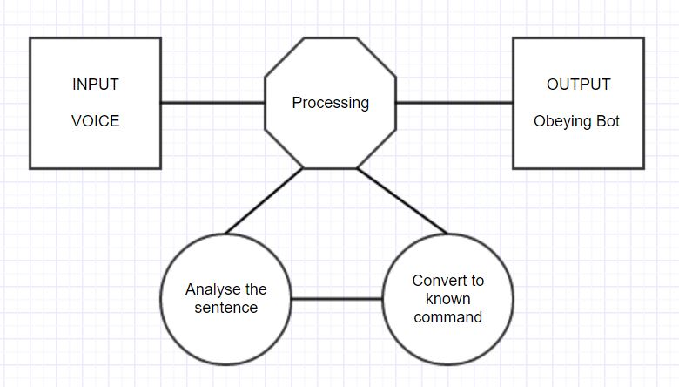
Block Diagram

Slide 6
Thank you

